Slide 1

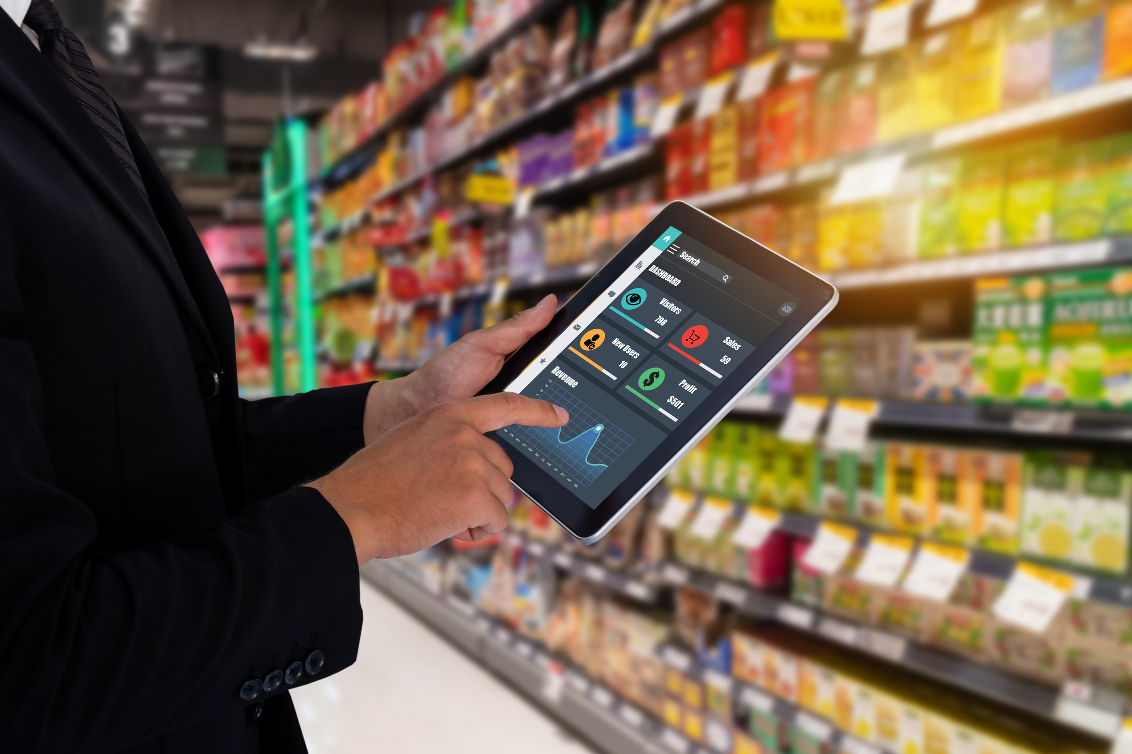



ATLIQ MART
1
NAMASTE ALL
ATLIQ
MART
PROMOTIONAL ANALYSIS
FOR
SALES DIRECTOR
AN INSIGHTFUL
REPORT
An Ad-hoc requests SQL Challenge led Insights Report conducted by CODEBASICS for ATLIQ MART
CREATED BY:
KUMAR VAISHNAV

Slide 2
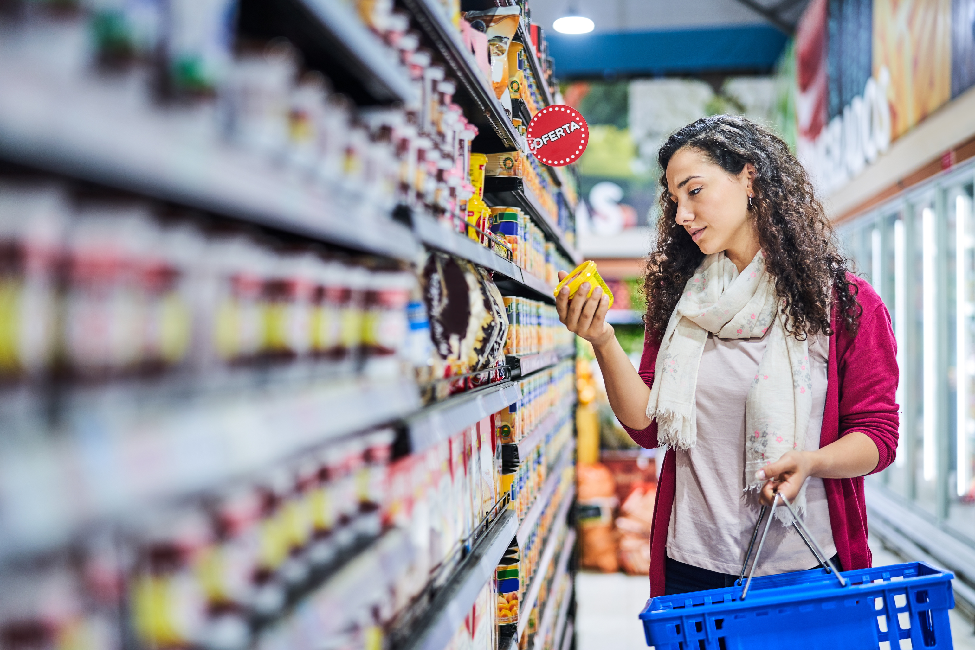





ATLIQ MART
2
TABLE OF CONTENT
ABOUT PROJECT
3
COMPANY OVERVIEW
4-5
PROJECT APPROACH
6
AD-HOC REQUEST
7-14
RECOMMENDED INSIGHTS
15-16
CONTACT
17

Slide 3




ABOUT PROJECT
ATLIQ MART
3
ANALYSE PROMOTIONS AND PROVIDE TANGIBLE INSIGHTS TO SALES DIRECTOR
Domain: FMCG | | Function: Sales / Promotions
OBJECTIVES
Analyze promotion performance during Diwali 2023 and Sankranti 2024 to provide actionable insights for future promotional strategies.
DELIVERABLES
Thorough analysis of promotion effectiveness, dashboard with key metrics, SQL-based reports for ad-hoc requests, compelling presentation.
IMPACT
Informed decisions for optimizing future promotions, increased sales, enhanced customer satisfaction, and improved profitability.

Slide 4







COMPANY OVERVIEW
ATLIQ MART
4
AtliQ Mart is a retail giant with over 50 supermarkets in the southern region of BHARAT(India).
Their Product lines division are as:
Atliq_Home_Essential_8_Product_Combo
Atliq_High_Glo_15W_LED_Bulb
COMBO 1
HOME APPLIANCES
Atliq_waterproof_Immersion_Rod
Atliq_Body_Milk_Nourishing_Lotion (120ML)
Atliq_Masoor_Dal (1KG)
Atliq_Cream_Beauty_Bathing_Soap (125GM)
GROCERY & STAPLES
Atliq_Sonamasuri_Rice (10KG)
PERSONAL CARE
Atliq_Doodh_Kesar_Body_Lotion (200ML)
Atliq_Suflower_Oil (1L)
Atliq_Lime_Cool_Bathing_Bar (125GM)
Atliq_Farm_Chakki_Atta (1KG)
HOME CARE
Atliq_Scrub_Sponge_For_Dishwash
Atliq_Fusion_Container_Set_of_3
Atliq_Curtains
CATEGORY
Atliq_Double_Bedsheet_set
PRODUCT

Slide 5


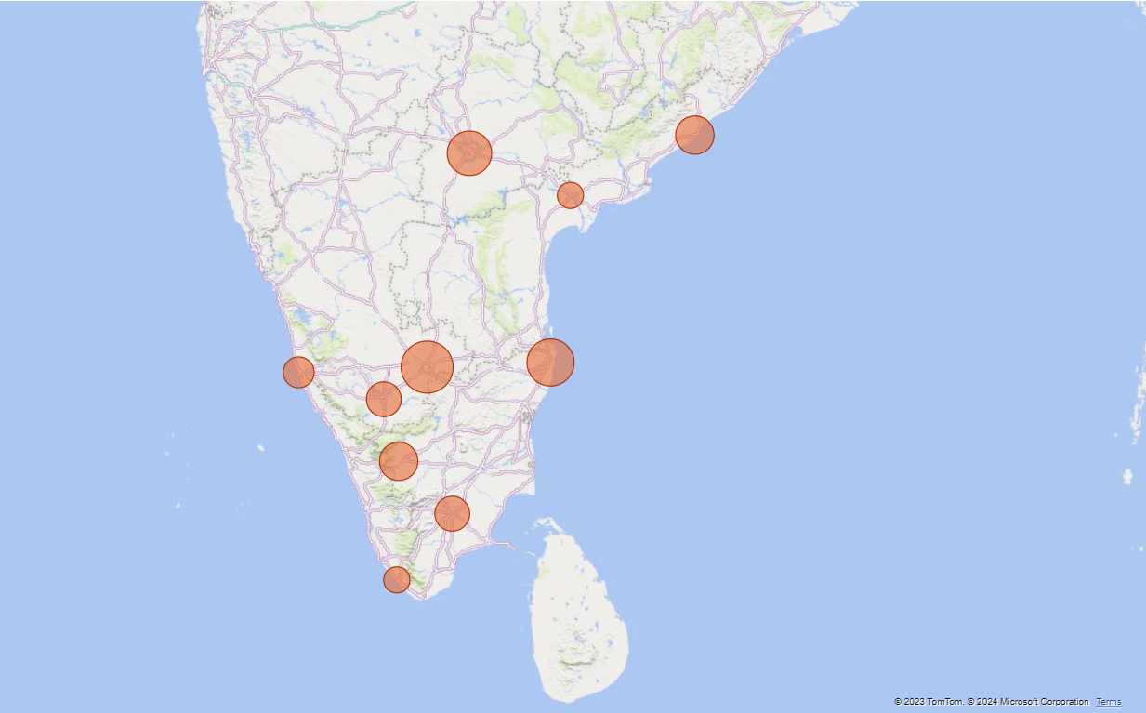


ATLIQ MART
5
ATLIQ MART RETAIL MARKET, & #STORES
PROMOTIONS
25% OFF
HYDERABAD
7
VISAKHAPATNAM
5
33% OFF
VIJAYAWADA
18
50% OFF
VIJAYAWADA
2
500 CASHBACK
BENGALURU
10
BOGOF
CHENNAI
18
MANGALORE
3
CHENNAI
8
MYSURU
4
COIMBATORE
5
MADURAI
18
MADURAI
4
CAMPAIGNS
TRIVANDRUM
18
TRIVANDRUM
2
DIWALI
(12 NOV 2023 - 18 NOV 2023)
SANKRANTI
(10 JAN 2024 - 16 JAN 2024)

Slide 6


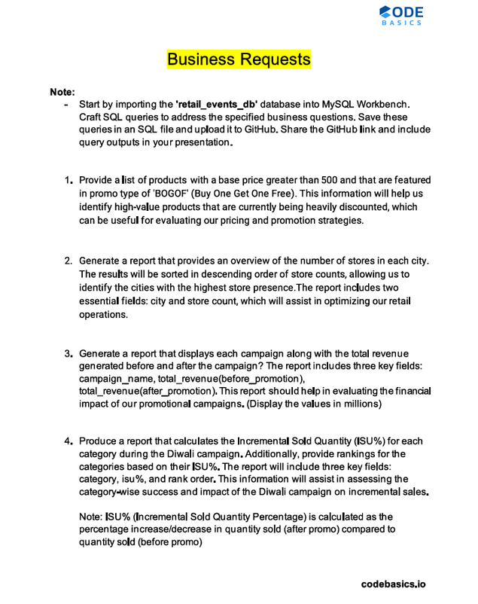
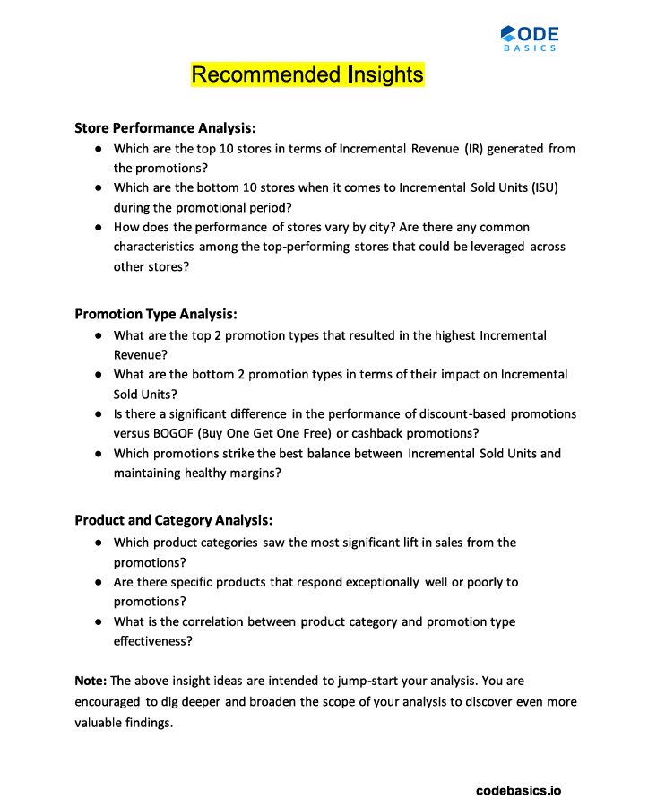
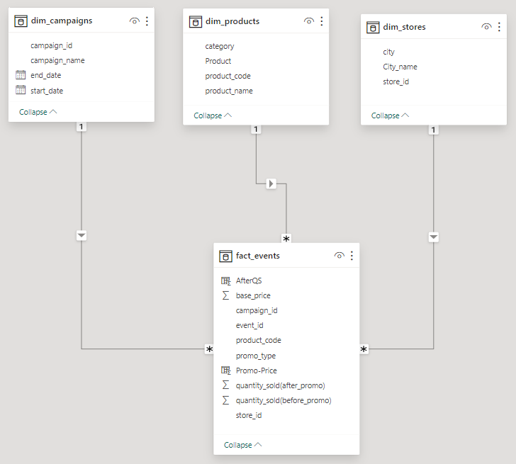
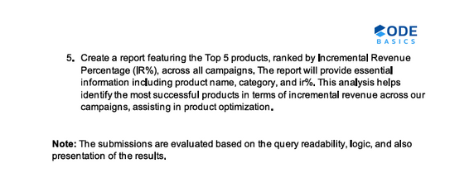





PROJECT APPROACH
ATLIQ MART
6
DATA & REQUEST GATHERIN﻿G
DATA MODELLING
>>
ANALYSIS & VISUALIZATION
FOR AD-HOC REQUESTS SQL ANALYSIS
Apart from the above request, “Retail_Events_DB” named Database also has been provided, and contains following Tables:
dim_campaigns
dim_stores
FOR DATA VISUALIZATION & INSIGHTS
dim_products
fact_events

Slide 7



AD-HOC REQUEST
ATLIQ MART
7
DATA ANALYSIS & VISUALIZATION FOR SQL QUERIED AD-HOC REQUEST RESULTS
Provide a list of products with a base price greater than ₹500 and that are featured in promo type of ‘BOGOF” (Buy one Get One Free). This information will help us identify high-value products that are being heavily discounted, which can be useful for evaluating our pricing and promotion strategies.
Generate a report that provides an overview of the number of stores in descending order of store counts, allowing us to identify the cities with the highest store presence. The report includes two essential fields: city and store count, which will assist in optimizing our retail operations.
Generate a report that displays each campaign along with the total revenue generated before and after the campaign. The report includes three key fields: campaign_name, total_revenue(before_promotion), and total_revenue(after_promotion). This report should help in evaluating the financial impact of our promotional campaigns. (Display the value in millions)
Produce a report that includes the Incremental Sold Quantity (ISU%) for each category during the Diwali campaign. Additionally, provide rakings for the categories based on their ISU%. The report will include three key fields: category, ISU%, and rank_order. This information will assist in assessing the category-wise success and impact of the Diwali campaign on incremental sales.
Create a report featuring the Top 5 products, ranked by Incremental Revenue Percentage (IR%), across all campaigns. The report will provide essential information including product_name, category, and IR%, This analysis helps identify the most successful products in terms of incremental revenue across our campaigns, assisting in product optmization.

Slide 8


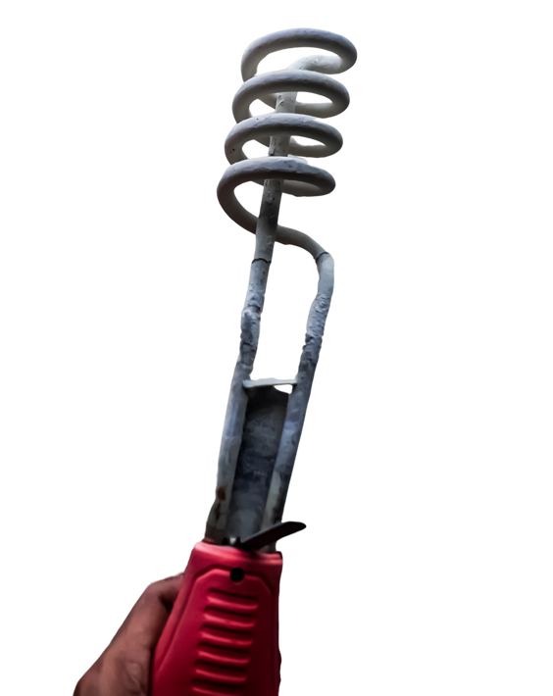
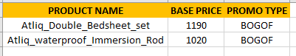
ATLIQ MART
8
1
Provide a list of products with a base price greater than ₹500 and that are featured in promo type of ‘BOGOF” (Buy one Get One Free). This information will help us identify high-value products that are being heavily discounted, which can be useful for evaluating our pricing and promotion strategies.
INSIGHTS ON HIGH-VALUE BOGOF PROMOTIONS:
SQL QUERY
SELECT
dp.product_name,
fe.base_price,
fe.promo_type
FROM
dim_products dp
JOIN
fact_events fe
ON
dp.product_code = fe.product_code
WHERE
fe.base_price > 500 AND fe.promo_type = 'BOGOF'
GROUP BY
dp.product_name, fe.base_price, fe.promo_type;
BASE
PRICE
₹1190
₹1020
PRODUCT NAME
Atliq_Double_Bedsheet_set
Atliq_waterproof_Immersion_Rod
OUTPUT
Premium Discounts: Products priced above ₹500 like Atliq_Double_Bedsheet_set and Atliq_waterproof_Immersion_Rod are BOGOF discounted.
Strategic Value: These promotions offer significant savings, potentially attracting more customers, enhancing sales volume.
Evaluation Importance: Analyzing BOGOF strategies for high-priced items crucial for pricing and promotion optimizations.

Slide 9
ATLIQ MART
9
2
Generate a report that provides an overview of the number of stores in descending order of store counts, allowing us to identify the cities with the highest store presence. The report includes two essential fields: city and store count, which will assist in optimizing our retail operations.
OVERVIEW OF STORE PRESENCE BY CITY:
SQL QUERY
SELECT
City,
count(store_id) AS 'store count'
FROM
dim_stores ds
GROUP BY
City
ORDER BY 2 DESC;
HYDERABAD
7
VISAKHAPATNAM
5
VIJAYAWADA
2
VIJAYAWADA
18
BENGALURU
10
CHENNAI
18
MANGALORE
3
CHENNAI
8
OUTPUT
MYSURU
4
COIMBATORE
5
MADURAI
18
MADURAI
4
TRIVANDRUM
18
TRIVANDRUM
2
Bengaluru Leads: Bengaluru boasts the highest store count with 10 outlets, indicating a significant retail presence.
Regional Distribution: Chennai and Hyderabad follow closely with 8 and 7 stores respectively, showcasing substantial urban coverage.
Tiered Presence: Coimbatore, Visakhapatnam, Madurai, and Mysuru feature moderately with 4-5 stores, ensuring regional accessibility.

Slide 10
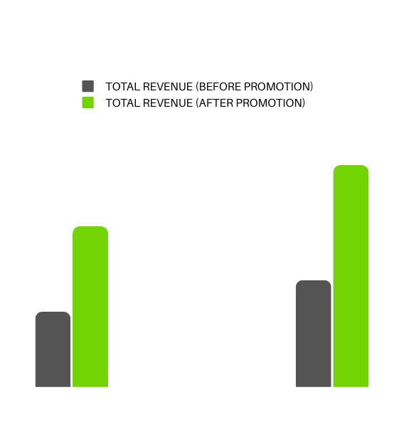


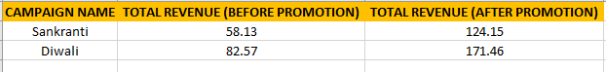
ATLIQ MART
10
3
Generate a report that displays each campaign along with the total revenue generated before and after the campaign. The report includes three key fields: campaign_name, total_revenue(before_promotion), and total_revenue(after_promotion). This report should help in evaluating the financial impact of our promotional campaigns. (Display the value in millions)
SQL QUERY
FINANCIAL IMPACT OF PROMOTIONAL CAMPAIGNS:
SELECT
dc.campaign_name,
ROUND(SUM(fe.base_price * fe.`quantity_sold(before_promo)`) / 1000000.0, 2) AS
"total_revenue(before_promotion)",
ROUND(SUM(
case
when promo_type = "50% OFF" then base_price*0.5*fe.`quantity_sold(after_promo)`
when promo_type = "25% OFF" then base_price*0.75*fe.`quantity_sold(after_promo)`
when promo_type = "33% OFF" then base_price*0.67*fe.`quantity_sold(after_promo)`
when promo_type = "500 Cashback" then (base_price-500)*fe.`quantity_sold(after_promo)`
when promo_type = "BOGOF" then base_price*0.5*fe.`quantity_sold(after_promo)`*2
end
) / 1000000.0, 2) AS "total_revenue(after_promotion)"
FROM
dim_campaigns dc
JOIN
fact_events fe ON dc.campaign_id = fe.campaign_id
GROUP BY
dc.campaign_name;
171.46M
124.15M
82.57M
58.13M
CAMPAIGN NAME
SANKRANTI
DIWALI
Sankranti Surge: Revenue soared from ₹58.13M to ₹124.15M post-promotion, marking a substantial increase.
Diwali Delight: Revenue surged from ₹82.57M to ₹171.46M, showcasing impressive growth post-promotion.
Promotion Efficacy: Both the Sankranti and Diwali campaigns effectively doubled revenue, validating promotional effectiveness.
OUTPUT

Slide 11
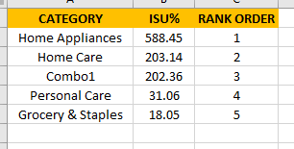







ATLIQ MART
11
4
Produce a report that includes the Incremental Sold Quantity (ISU%) for each category during the Diwali campaign. Additionally, provide rakings for the categories based on their ISU%. The report will include three key fields: category, ISU%, and rank_order. This information will assist in assessing the category-wise success and impact of the Diwali campaign on incremental sales.
NOTE: ISU%(Incremental Sold Quantity %) is calculated as the percentage increase/decrease in quantity sold(after promo) compared to quantity sold(before promo).
OUTPUT
ASSESSING DIWALI CAMPAIGN IMPACT:
CATEGORY
HOME APPLIANCES
588.45%
HOME CARE
203.14%
COMBO1
202.36%
PERSONAL CARE
31.06%
-570.4%
Home Appliances Dominance: Home Appliances category leads with a remarkable ISU% of 588.45%, securing the top rank.
Home Care and Combo1 Success: Home Care and Combo1 categories follow closely with ISU% of 203.14% and 202.36% respectively, securing second and third ranks.
Recommendation: Focus on promoting Home Appliances further, while sustaining efforts in Home Care and Combo1 for continued success.
GROCERY & STAPLES
18.05%
Explore Growth Areas:Investigate opportunities for expansion, particularly in GROCERY & STAPLES, to capitalize on market potential.

Slide 12
ATLIQ MART
12
SQL QUERY
WITH GroupedCategories AS (
SELECT
dp.category,
ROUND(SUM(
CASE
WHEN fe.promo_type = "BOGOF" THEN fe.`quantity_sold(after_promo)` * 2
ELSE fe.`quantity_sold(after_promo)`
END - fe.`quantity_sold(before_promo)`) / NULLIF(SUM(fe.`quantity_sold(before_promo)`), 0) * 100, 2) AS Total_ISU_Percentage
FROM
dim_products dp
JOIN
fact_events fe ON dp.product_code = fe.product_code
WHERE
fe.campaign_id = (SELECT campaign_id FROM dim_campaigns WHERE campaign_name = 'Diwali')
GROUP BY
dp.category),
RankedCategories AS (
SELECT
category,
Total_ISU_Percentage,
RANK() OVER (ORDER BY Total_ISU_Percentage DESC) AS Rank_Order
FROM
GroupedCategories)
SELECT
category,
Total_ISU_Percentage,
Rank_Order
FROM
RankedCategories;
OUTPUT

Slide 13
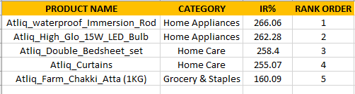



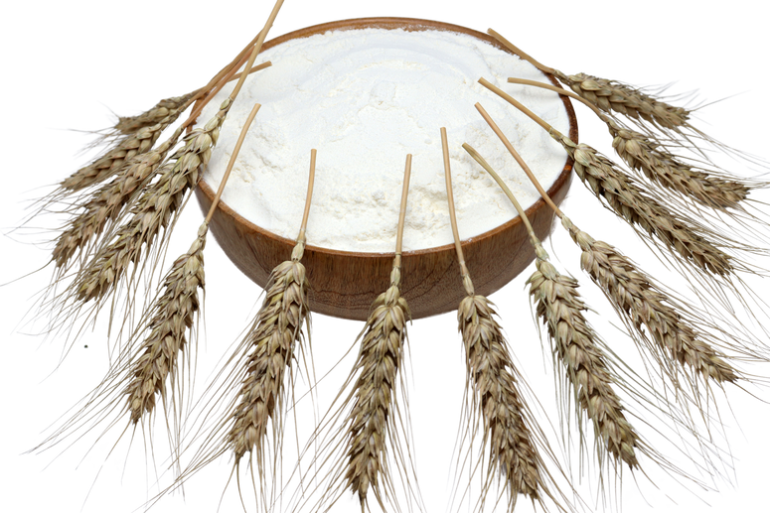
ATLIQ MART
13
5
Create a report featuring the Top 5 products, ranked by Incremental Revenue Percentage (IR%), across all campaigns. The report will provide essential information including product_name, category, and IR%, This analysis helps identify the most successful products in terms of incremental revenue across our campaigns, assisting in product optmization.
OUTPUT
INSIGHTS ON TOP PERFORMING PRODUCTS:
PRODUCT NAME
Atliq_waterproof_Immersion_Rod
266.06%
Atliq_High_Glo_15W_LED_Bulb
262.28%
Home Appliances Lead: Atliq_waterproof_Immersion_Rod and Atliq_High_Glo_15W_LED_Bulb dominate with highest IR%, ranking 1st and 2nd.
Home Care Success: Atliq_Double_Bedsheet_set and Atliq_Curtains follow closely, securing 3rd and 4th ranks respectively.
Strategic Focus: Prioritize stocking and promoting top-ranking products to maximize incremental revenue across campaigns.
Atliq_Double_Bedsheet_set
258.40%
Atliq_Curtains
255.07%
Atliq_Farm_Chakki_Atta (1KG)
160.09%

Slide 14
ATLIQ MART
14
SQL QUERY
WITH GroupedProducts AS (
SELECT
dp.product_name,
dp.category,
ROUND(SUM(
CASE
WHEN fe.promo_type = '50% OFF' THEN base_price * 0.5 * fe.`quantity_sold(after_promo)`
WHEN fe.promo_type = '25% OFF' THEN base_price * 0.75 * fe.`quantity_sold(after_promo)`
WHEN fe.promo_type = '33% OFF' THEN base_price * 0.67 * fe.`quantity_sold(after_promo)`
WHEN fe.promo_type = '500 Cashback' THEN (base_price - 500) * fe.`quantity_sold(after_promo)`
WHEN fe.promo_type = 'BOGOF' THEN base_price * 0.5 * fe.`quantity_sold(after_promo)` * 2
ELSE 0
END
) / 1000000.0, 2) AS Incremental_Revenue_Million,
ROUND(SUM(fe.base_price * fe.`quantity_sold(before_promo)`) / 1000000.0, 2) AS Total_Revenue_Before_Promotion
FROM
dim_products dp
JOIN
fact_events fe ON dp.product_code = fe.product_code
GROUP BY
dp.product_name, dp.category),
RankedProducts AS (
SELECT
product_name,
category,
ROUND((Incremental_Revenue_Million - Total_Revenue_Before_Promotion) / NULLIF(Total_Revenue_Before_Promotion, 0) * 100, 2) AS IR_Percentage,
RANK() OVER (ORDER BY (Incremental_Revenue_Million - Total_Revenue_Before_Promotion) / NULLIF(Total_Revenue_Before_Promotion, 0) DESC) AS Rank_Order
FROM
GroupedProducts)
SELECT
product_name,
category,
IR_Percentage,
Rank_Order
FROM
RankedProducts
LIMIT 5;
OUTPUT

Slide 15


RECOMMENDED INSIGHTS
ATLIQ MART
15
A Power BI Dashboard view Recommended Insights for sales Promotional Success. It includes :
STORE PERFORMANCE ANALYSIS
PROMOTIONAL TYPE ANALYSIS
PRODUCT AND CATEGORY ANALYSIS

Slide 16
ATLIQ MART
16

Slide 17
ATLIQ MART
16
STORE PERFORMANCE ANALYSIS
Mysore, Chennai & Bangalore predominant in top store location for promotions in Incremental Revenue. Combo1(Category) & 500 cashback(promo type) contributes the main revenue growth of nearly 60%.
Mangalore, Visakhapatnam & Vijayawada as tiered cities lies in bottom Incremental Sold Units store. Personal care(Category) & discount-based promotions contributes < 10% put lags in the Sold Unit growth .
IR serves as a clear indicator of promotion impact. Higher store count correlates with revenue growth, especially notable in Bangalore, Chennai, Hyderabad & Top-performing stores leverage Combo1(category) and Cashback promotions, contributing to approximately 60% of their success.
PROMOTIONAL TYPE ANALYSIS
Based on ISU% (which directly reflects the effectiveness of promotions in driving consumer purchases), BOGOF promotions outperform cashback (639.96% vs. 183.33%) and discount-based promotions (62.68%). Allocate resources to BOGOF for higher sales impact, ensuring optimal promotion strategy alignment.
Top 2 promotions by IR are "500 Cashback" (91.05M) and "BOGOF" (69.32M), while bottom 2 in ISU are "50% Off" (6.9K) and "25% Off" (-5.7K). Focus on optimizing ISU for discount-based promotions to enhance sales impact.
"500 Cashback" strikes a balance between ISU (40.9K) and margin% (57.65%), ensuring healthy sales and profitability. "BOGOF" maintains high ISU (372.3K) and margin% (72.78%), signifying robust sales impact with strong margins. Optimize "500 Cashback" promotions for balanced performance.
PRODUCT AND CATEGORY ANALYSIS
Atliq_Suflower_Oil (1L), Atliq_Farm_Chakki_Atta (1KG) excelled in BOGOF, while Personal care Products underperformed in 25% off.
Strong positive correlation observed between IR and ISU for Atliq Home Essential Combo(Combo1) and Atliq Farm Chakki Atta(Grocery).
The correlation between promotion type effectiveness and product category suggests a strong association. For instance, "BOGOF" promotions demonstrate high ISU% across Grocery & Staples, Home Appliances, and Home Care categories, indicating their efficacy. Focus on optimizing promotion types per category accordingly.
Home Appliances and Home Care categories saw the most significant lift in sales, of nearly 2-3X growth with products like Atliq waterproof Immersion Rod and Atliq Double Bedsheet set leading the surge. Focus on optimizing promotions for these categories to capitalize on sales growth.

Slide 18








ATLIQ MART
17
DHANYAWAD
ATLIQ
MART
CODE
BASICS
FOR PROJECT OPPORTUNITY
LET'S CONNECT
+91-9693557965
jobsforkumar.vaishnav@gmail.com
www.kumarvaishnav.in
Kumar Vaishnav

